Slide 1
HELICOPTER PESTICIDE APPLICATION
NONE OF THE MYTHS.
JUST THE FACTS.

Slide 2
WHY CHOOSE AERIAL APPLICATION
Timely applications not affected by wet ground conditions.
Large acreage coverage in short time frame.
No soil compaction.
No production loss from tramping.
No fungal disease spread from field to field.
No damage to stock or tassel.

Slide 3
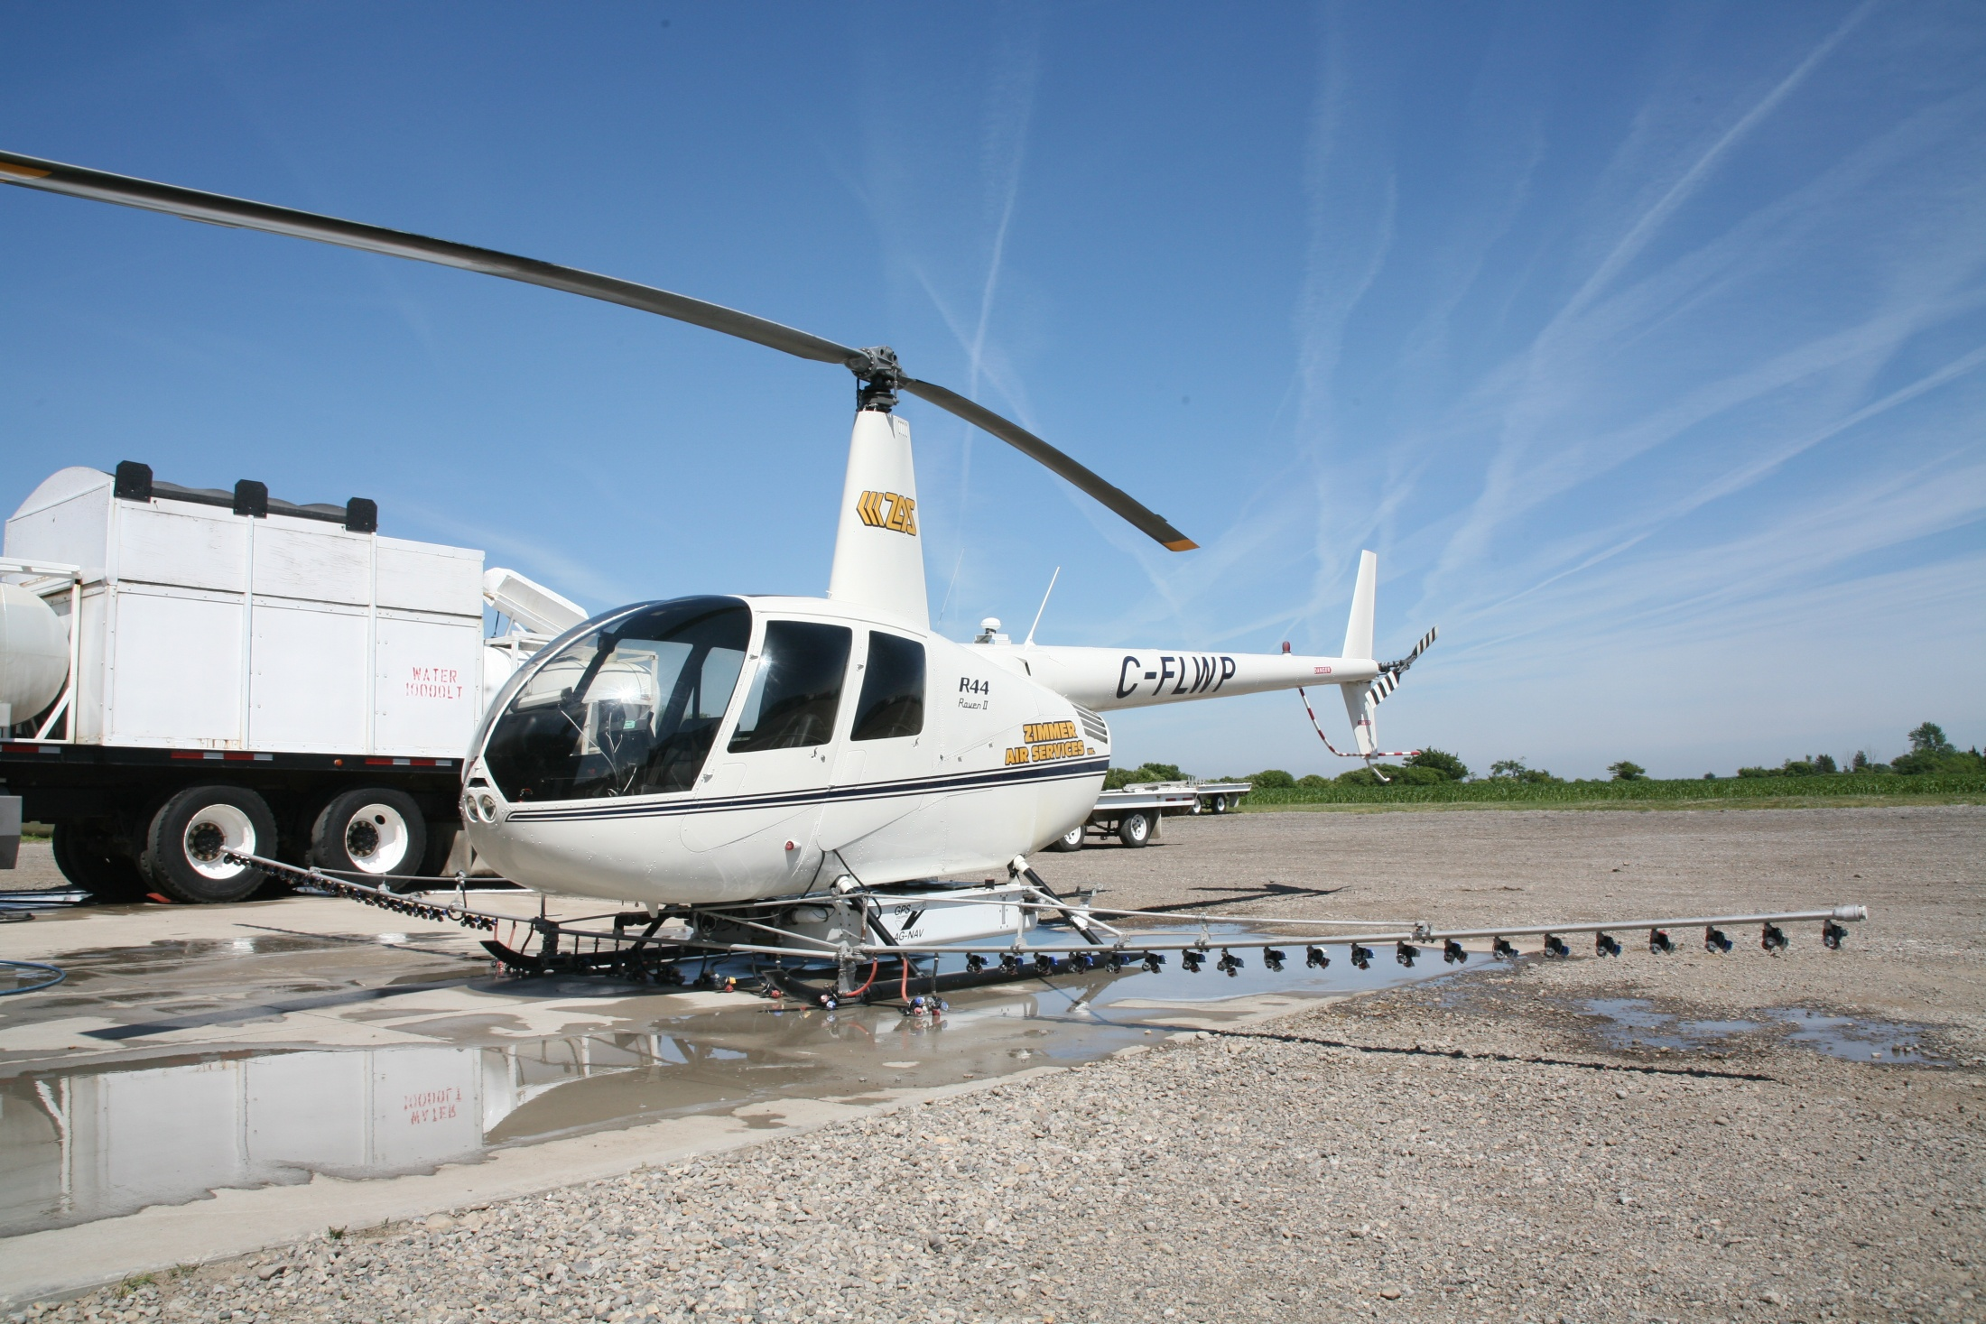

Slide 4
WHY CHOOSE HELICOPTER
Excellent coverage especially in smaller or irregular fields.
Ability to manoeuvre around obstacles and irregular boundaries due to slower flight speeds.
No airstrips required.
Usually exceeds production of fixed wing counterpart on most fields when factoring in ferry time.
Where obstacles exist helicopters are able to get to optimum spray height quicker and remain at that height longer when exiting the field resulting in better coverage.

Slide 5
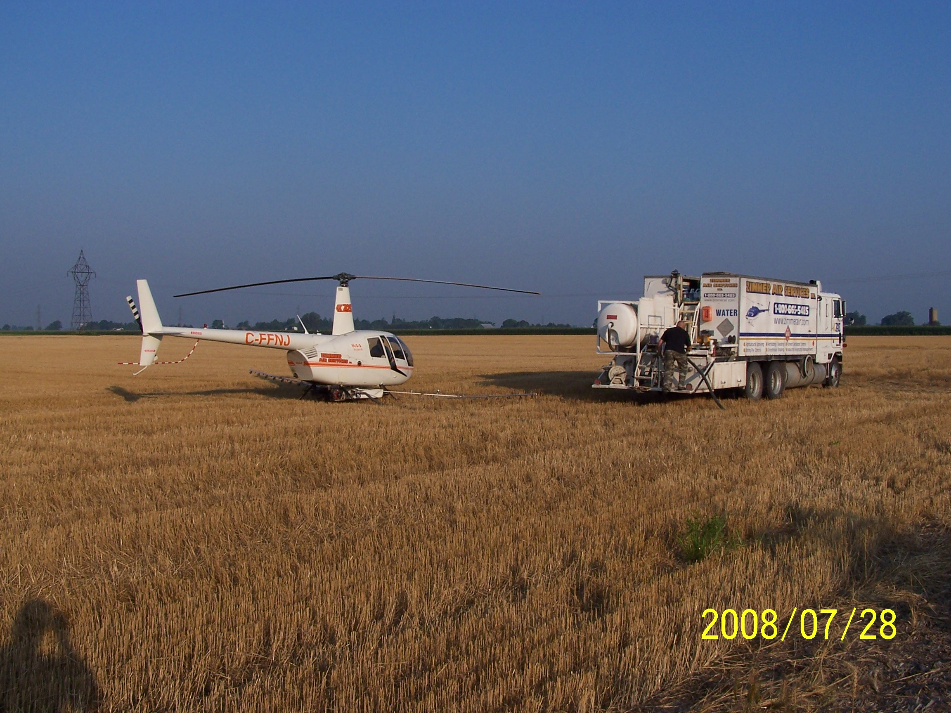
Zimmer Air Services Mix & Load Setup

Slide 6
WHY CHOOSE ZIMMER AIR SERVICES
34 years of service to the farmer & agribusiness.
Over 3,000,000 ag/forestry acres sprayed.
Highly trained & experienced crews.
Modern, well maintained aircraft equipped with the latest in GPS spray guidance technology.
Transport Canada Licensed Air Operator.
Fully insured – 5M public liability/500K drift.
Multiple ship fleet ensures timely applications.
Proven safety and satisfaction record.
Competitive pricing with other applicators.

Slide 7
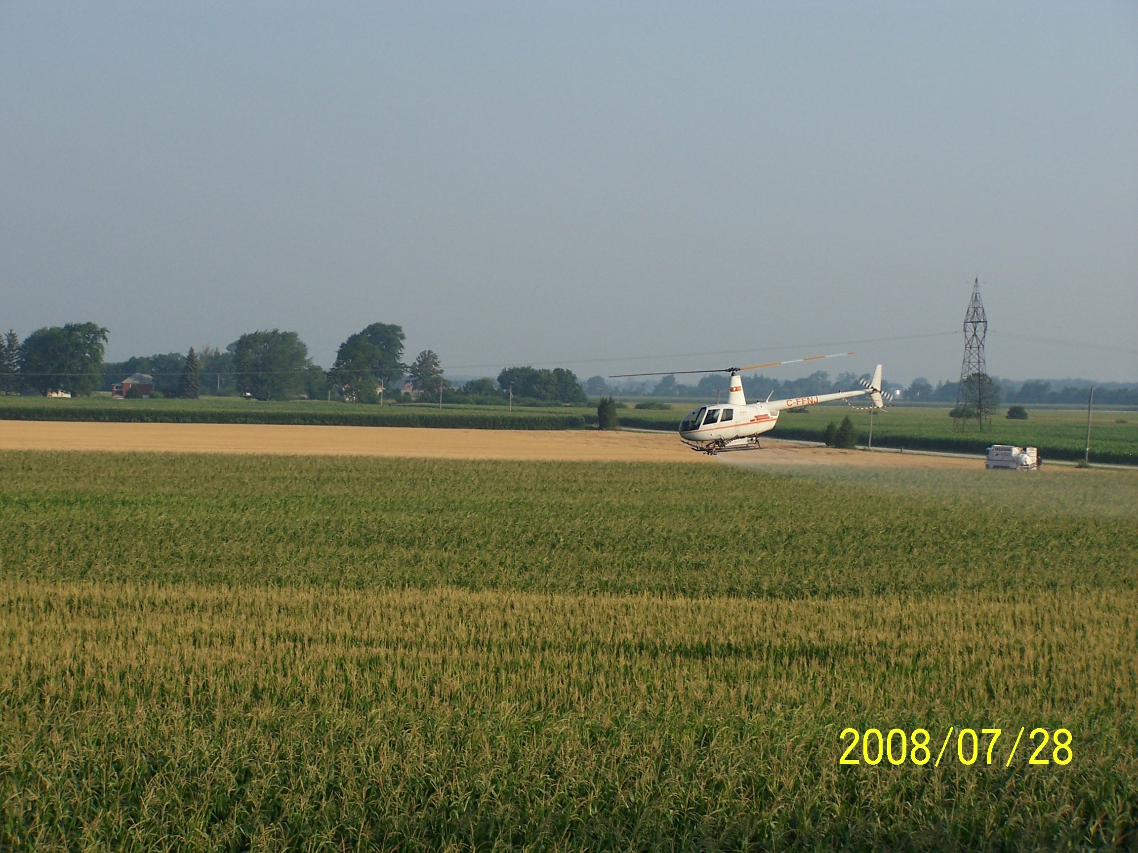
Headline Application on Corn

Slide 8
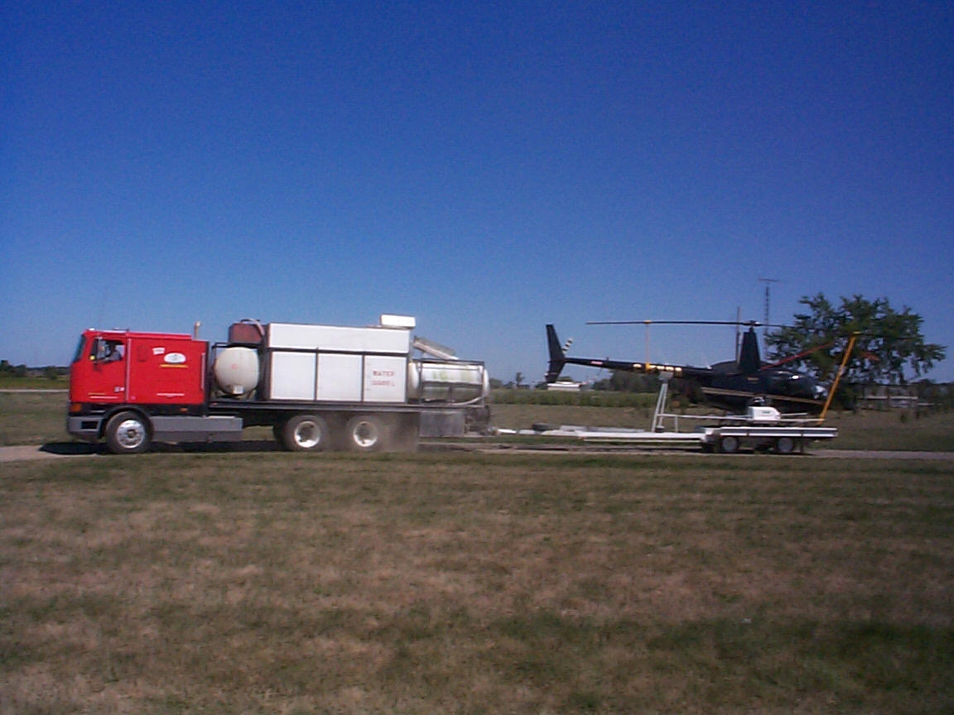
Ground transport ensures we can get to the field earlier, start spraying earlier and work later.
It also cuts down on operating costs, so we can remain competitive with other modes of aerial application.

Slide 9
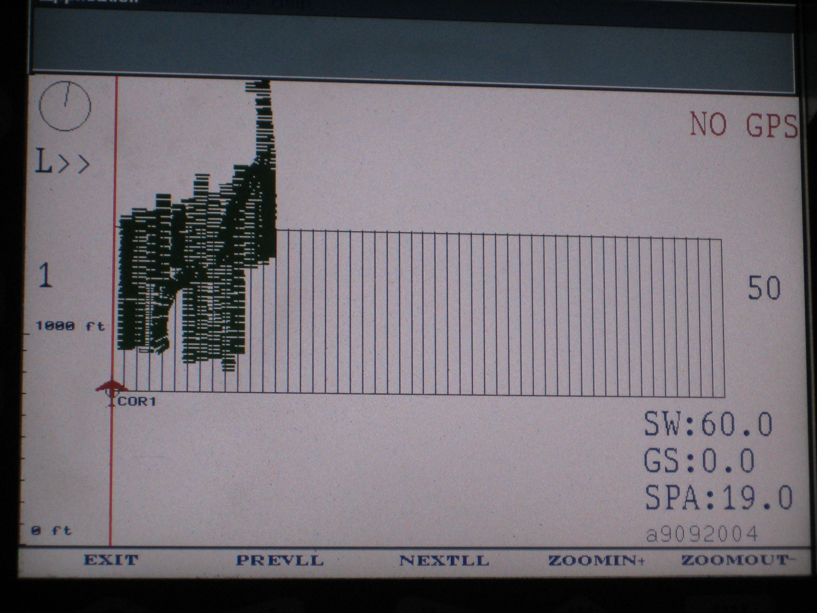
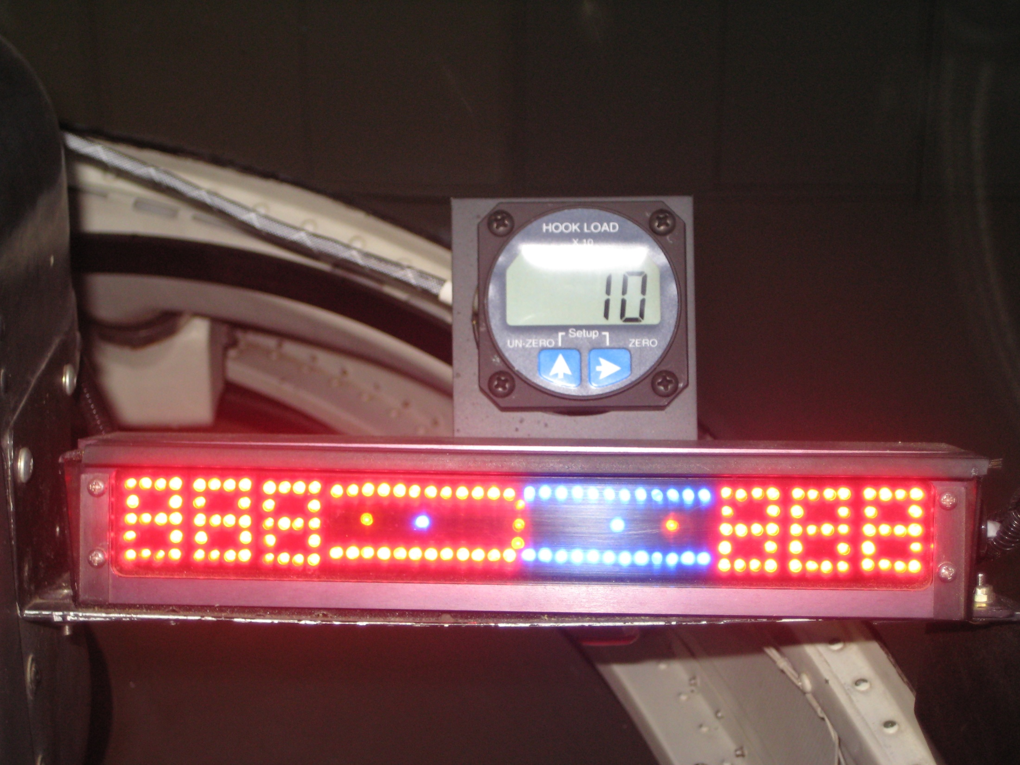
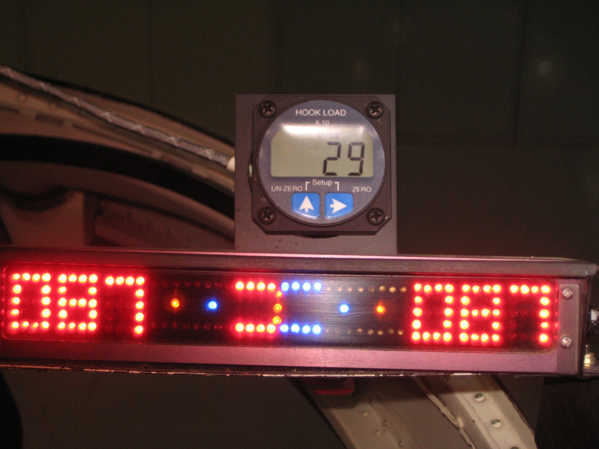
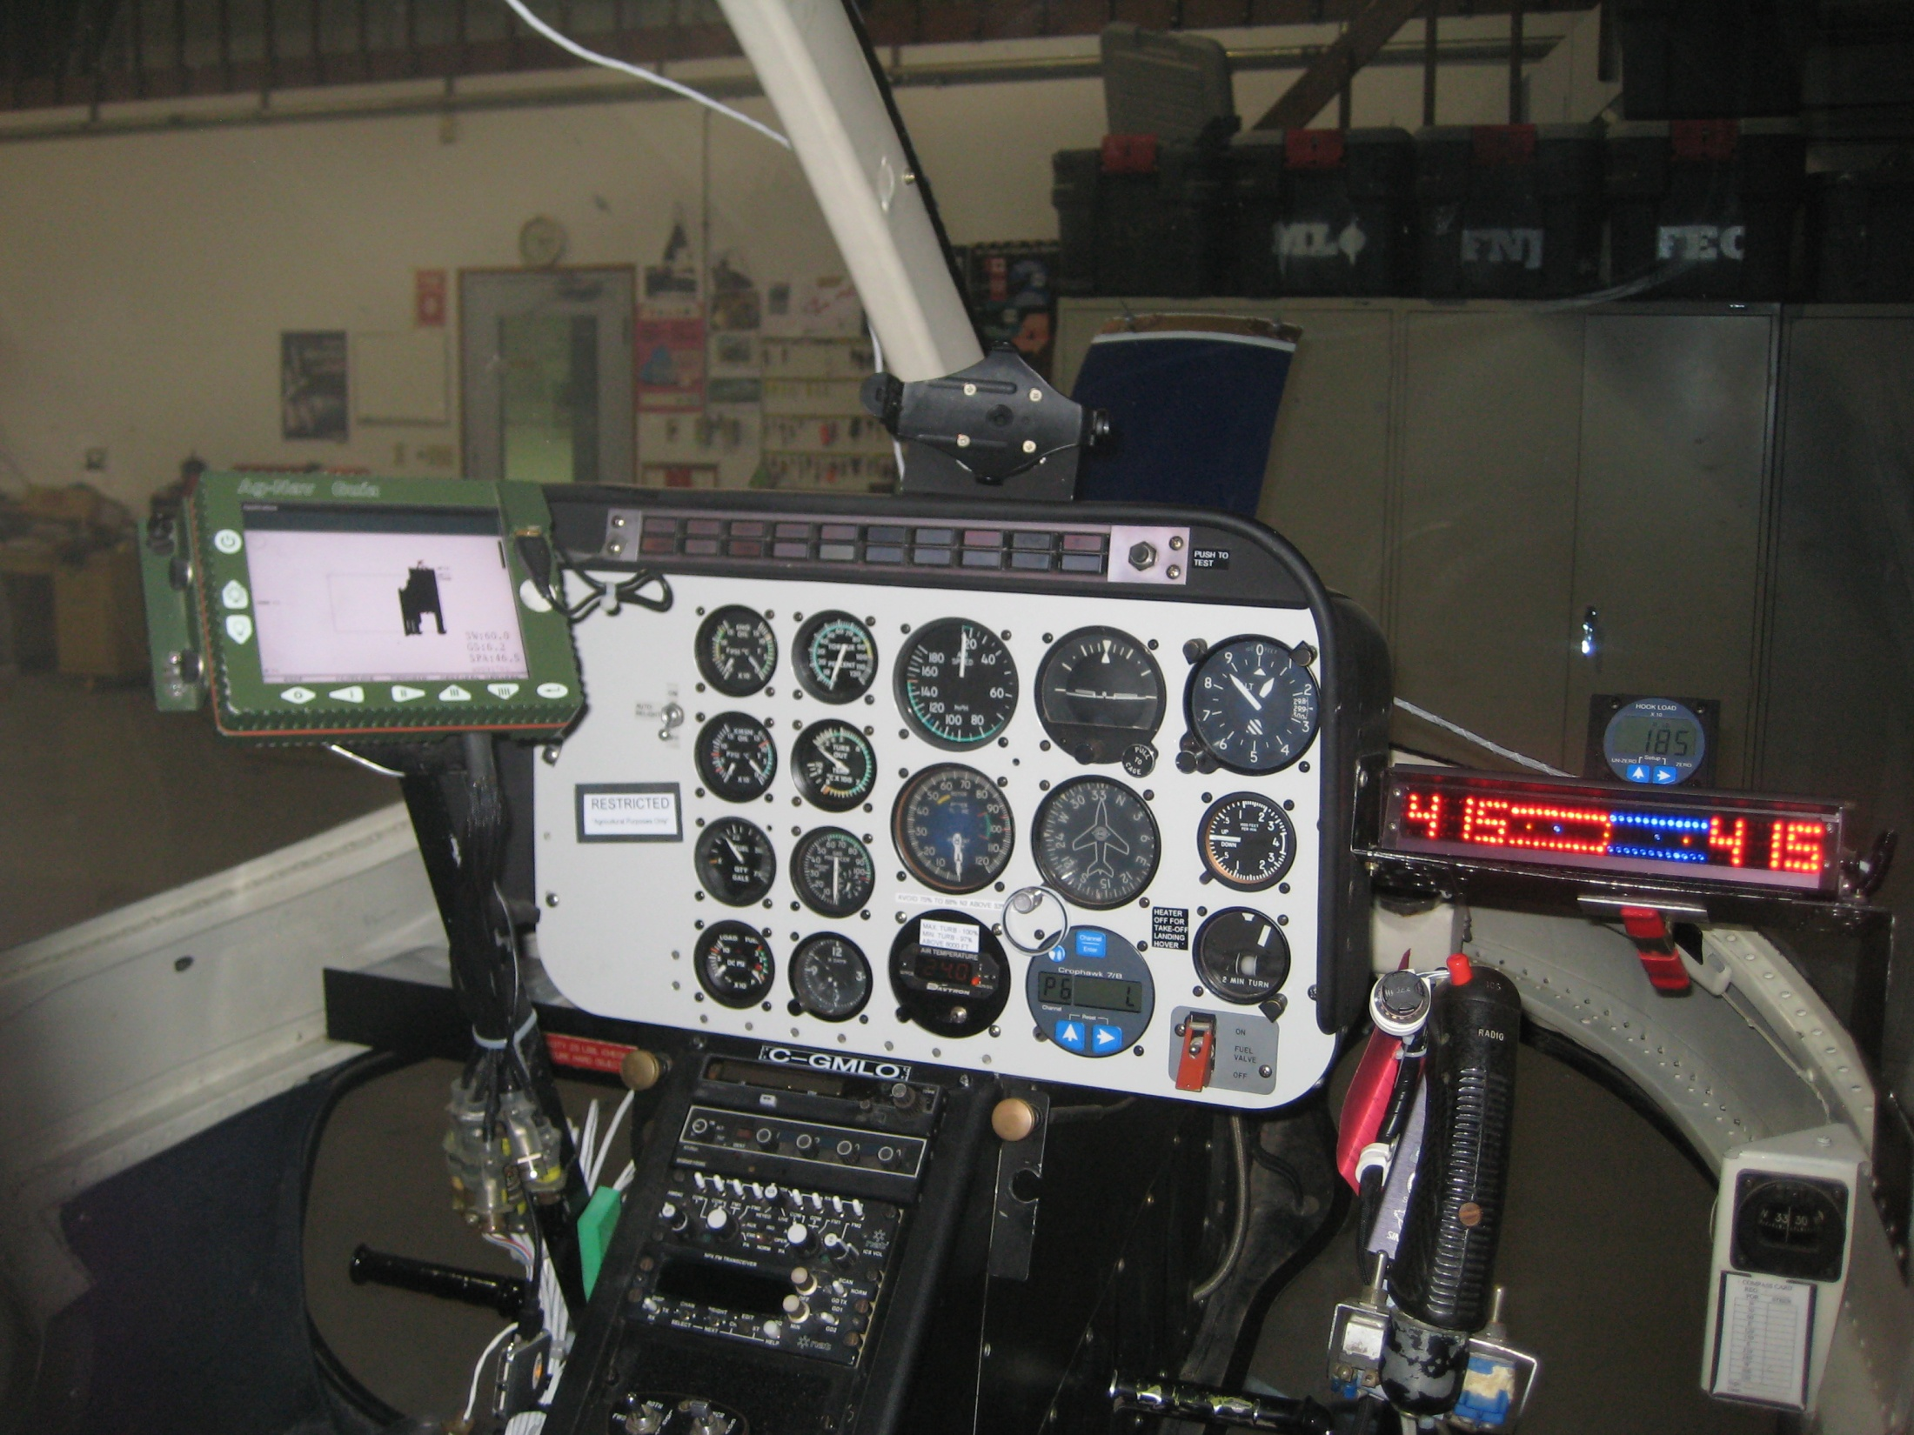
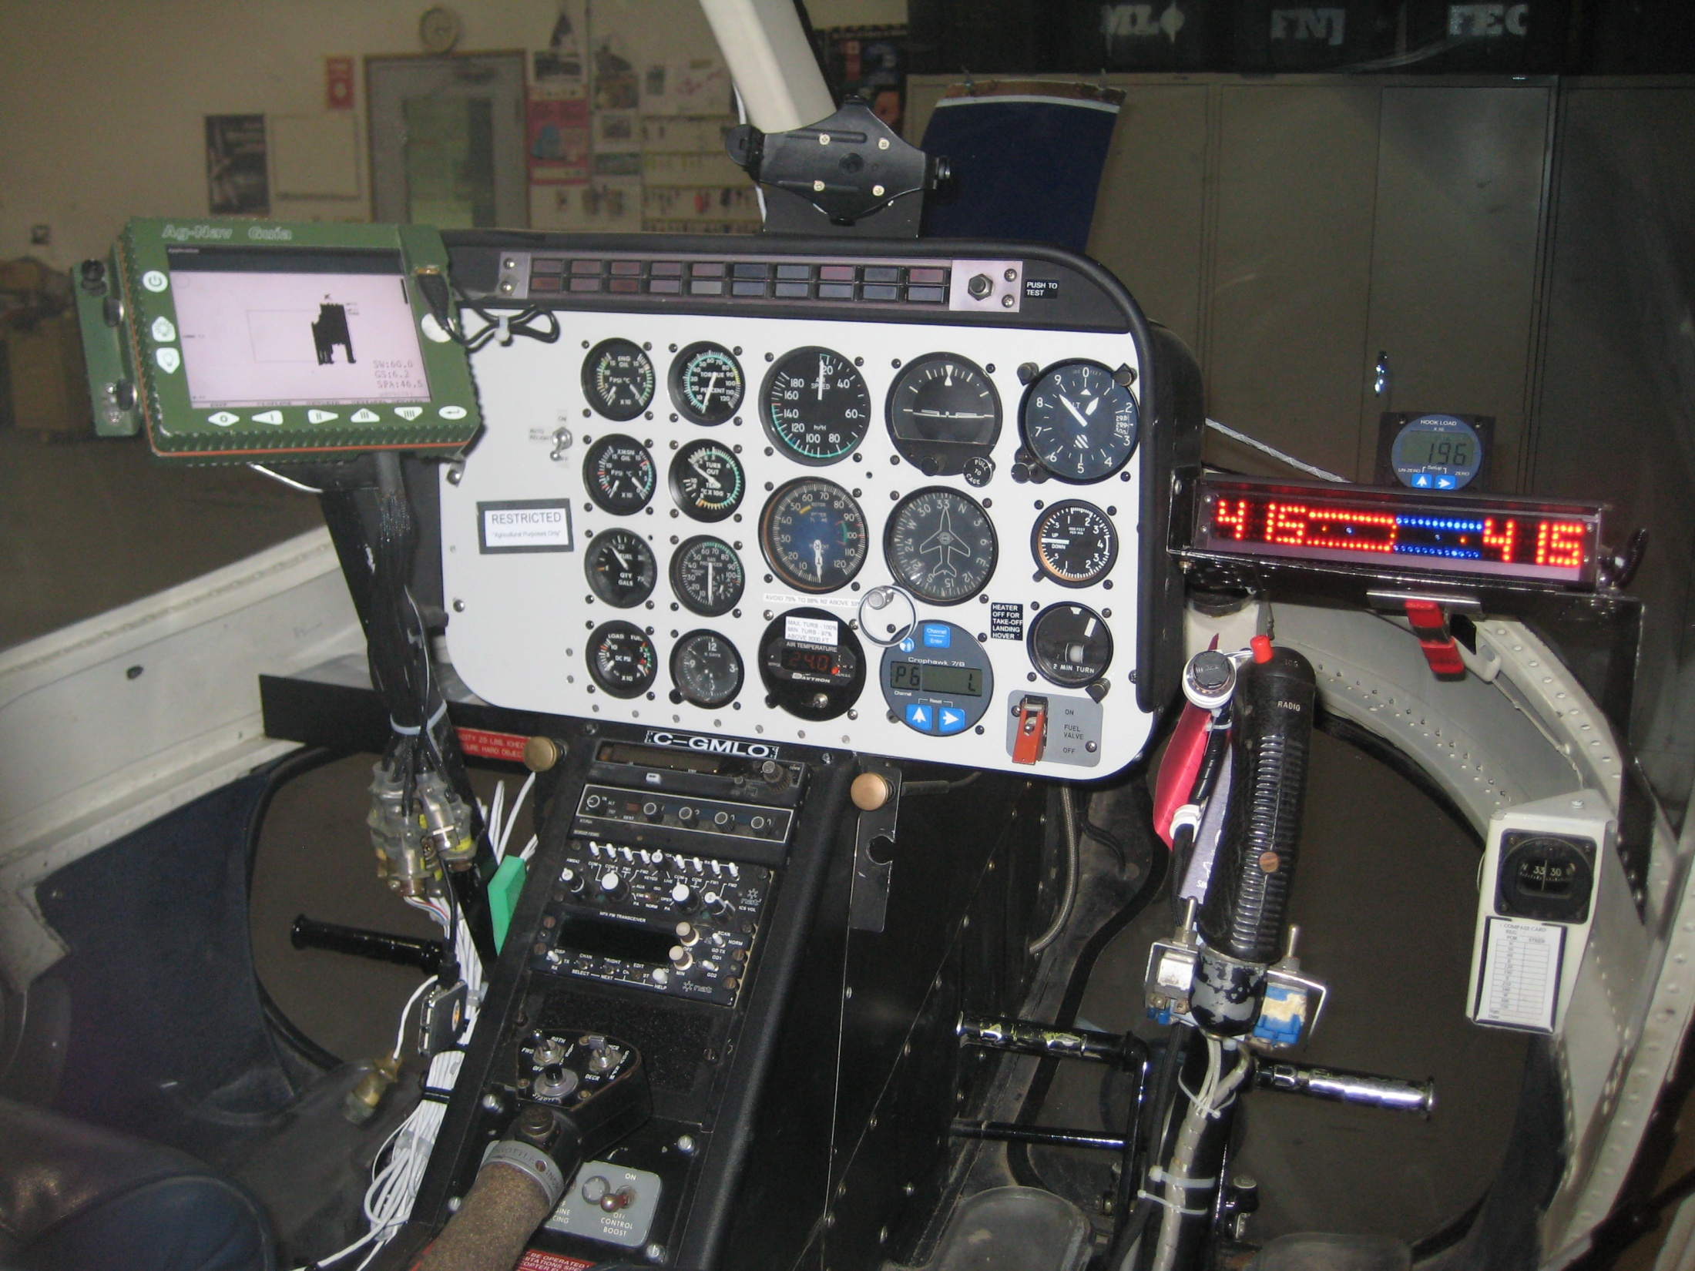
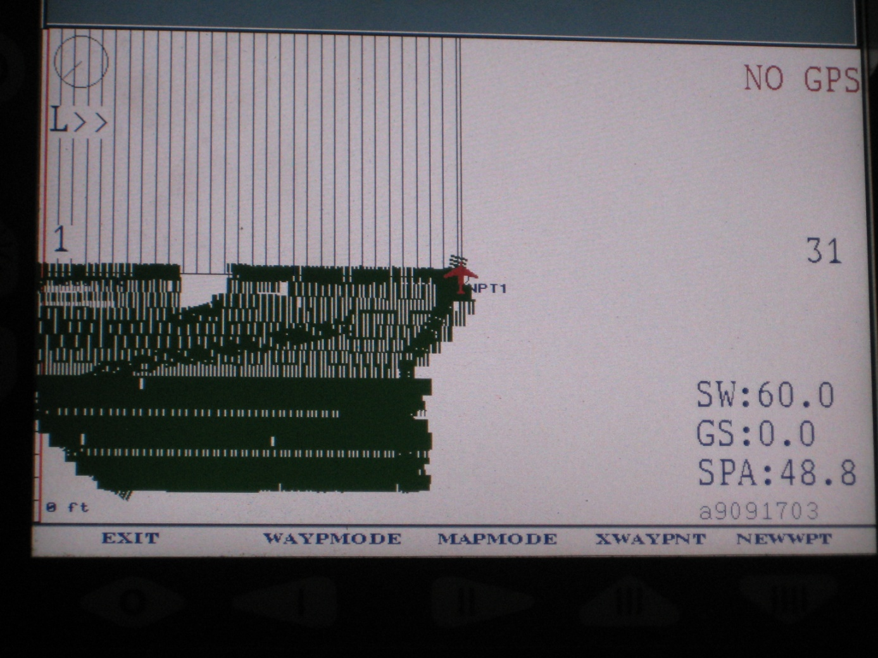
Helicopter cockpit with moving map, track spacing light bar, & flow monitor.

Slide 10
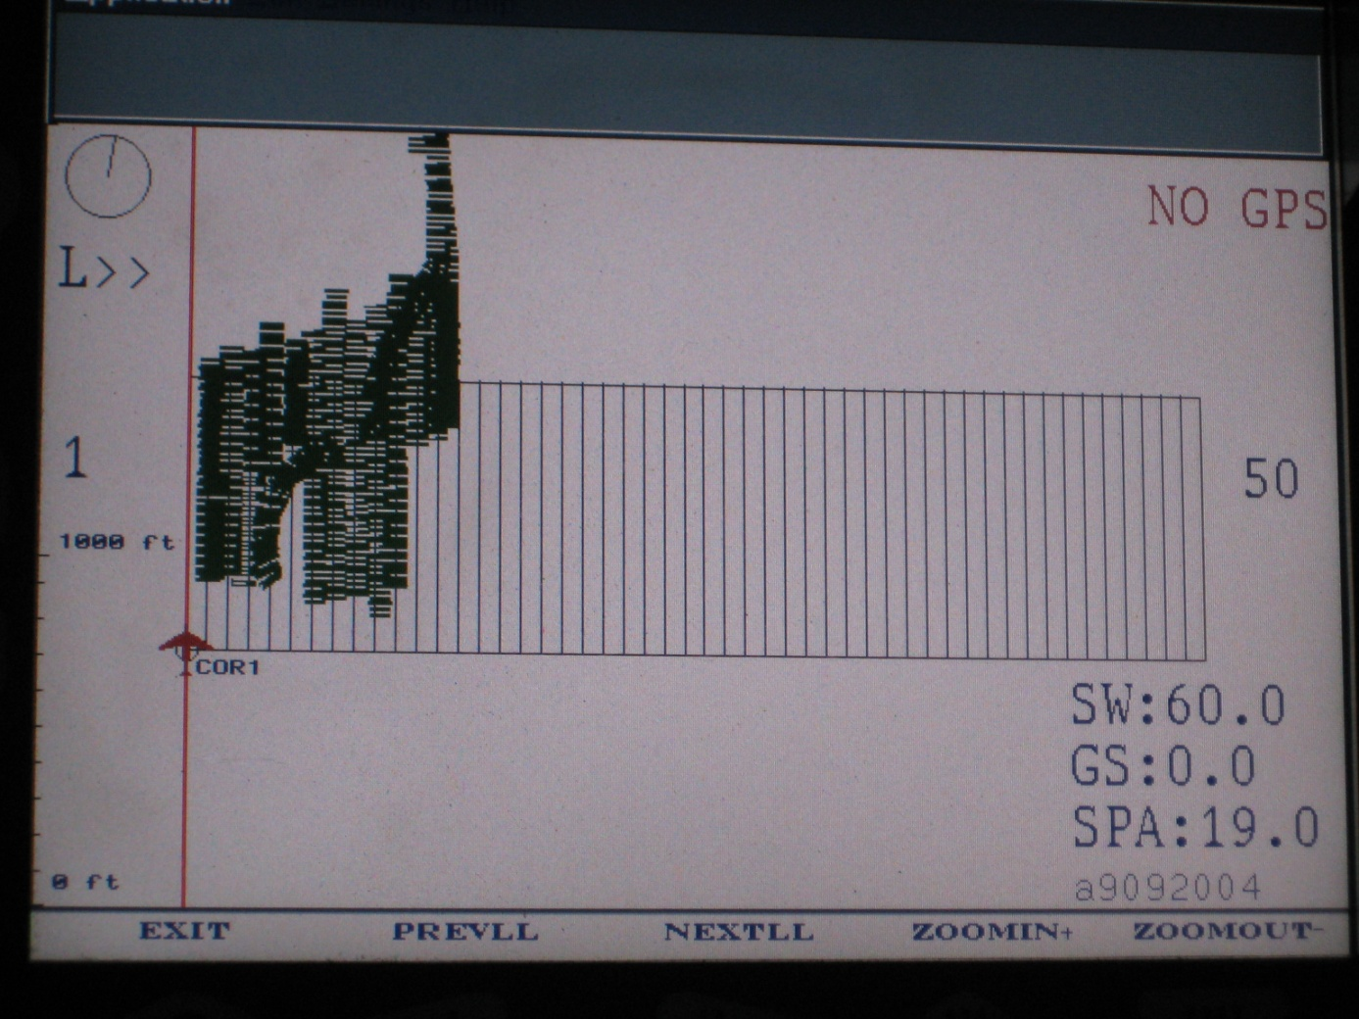
Onboard Real time GIS Data to ensure complete coverage of crop.
Swath
Ground Speed
Acres sprayed

Slide 11
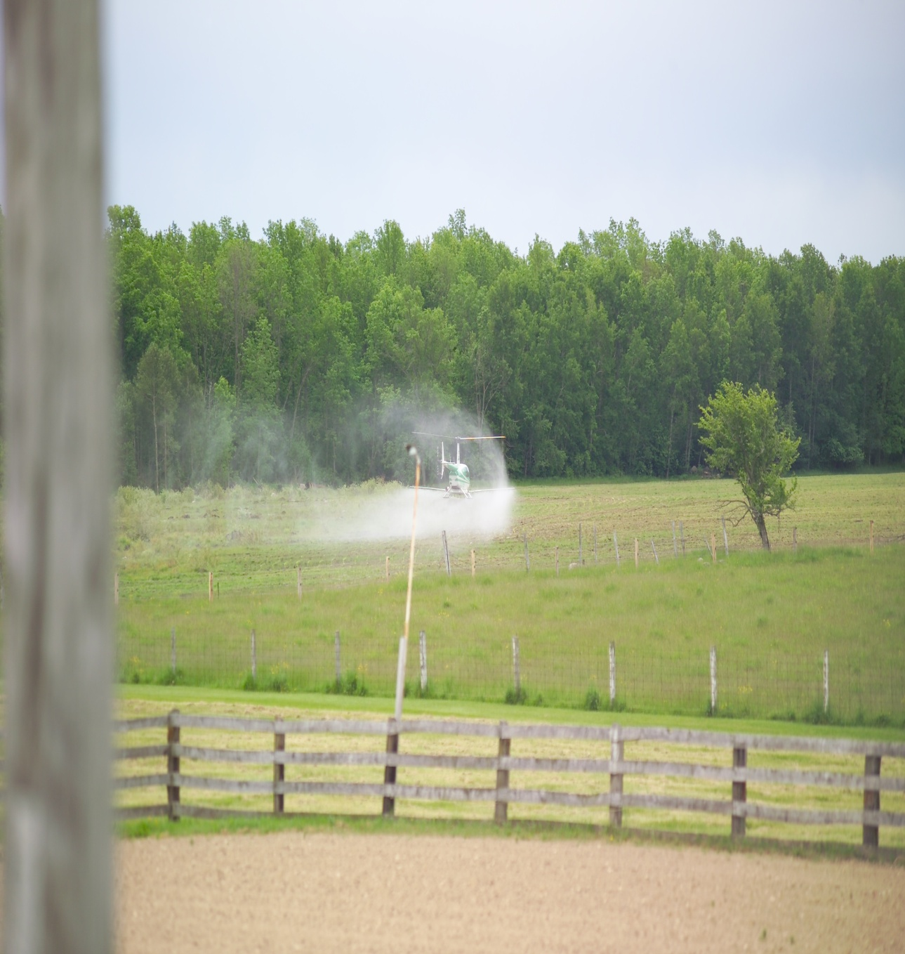
ALL HELICOPTER APPLICATORS ARE NOT CREATED EQUAL!
The operator of this helicopter, “NOT ZIMMER AIR” clearly demonstrates their lack of understanding of the principles of calibration and basic aerial application principles.
High Application Pressure
+
Incorrect Nozzle Selection
+
Incorrect Nozzle Placement =
Incorrect droplet spectrum (high percentage of fines) resulting in,
Excessive off target drift,
Increased evaporation,
Reduced active reaching the target vegetation decreasing efficacy.

Slide 12
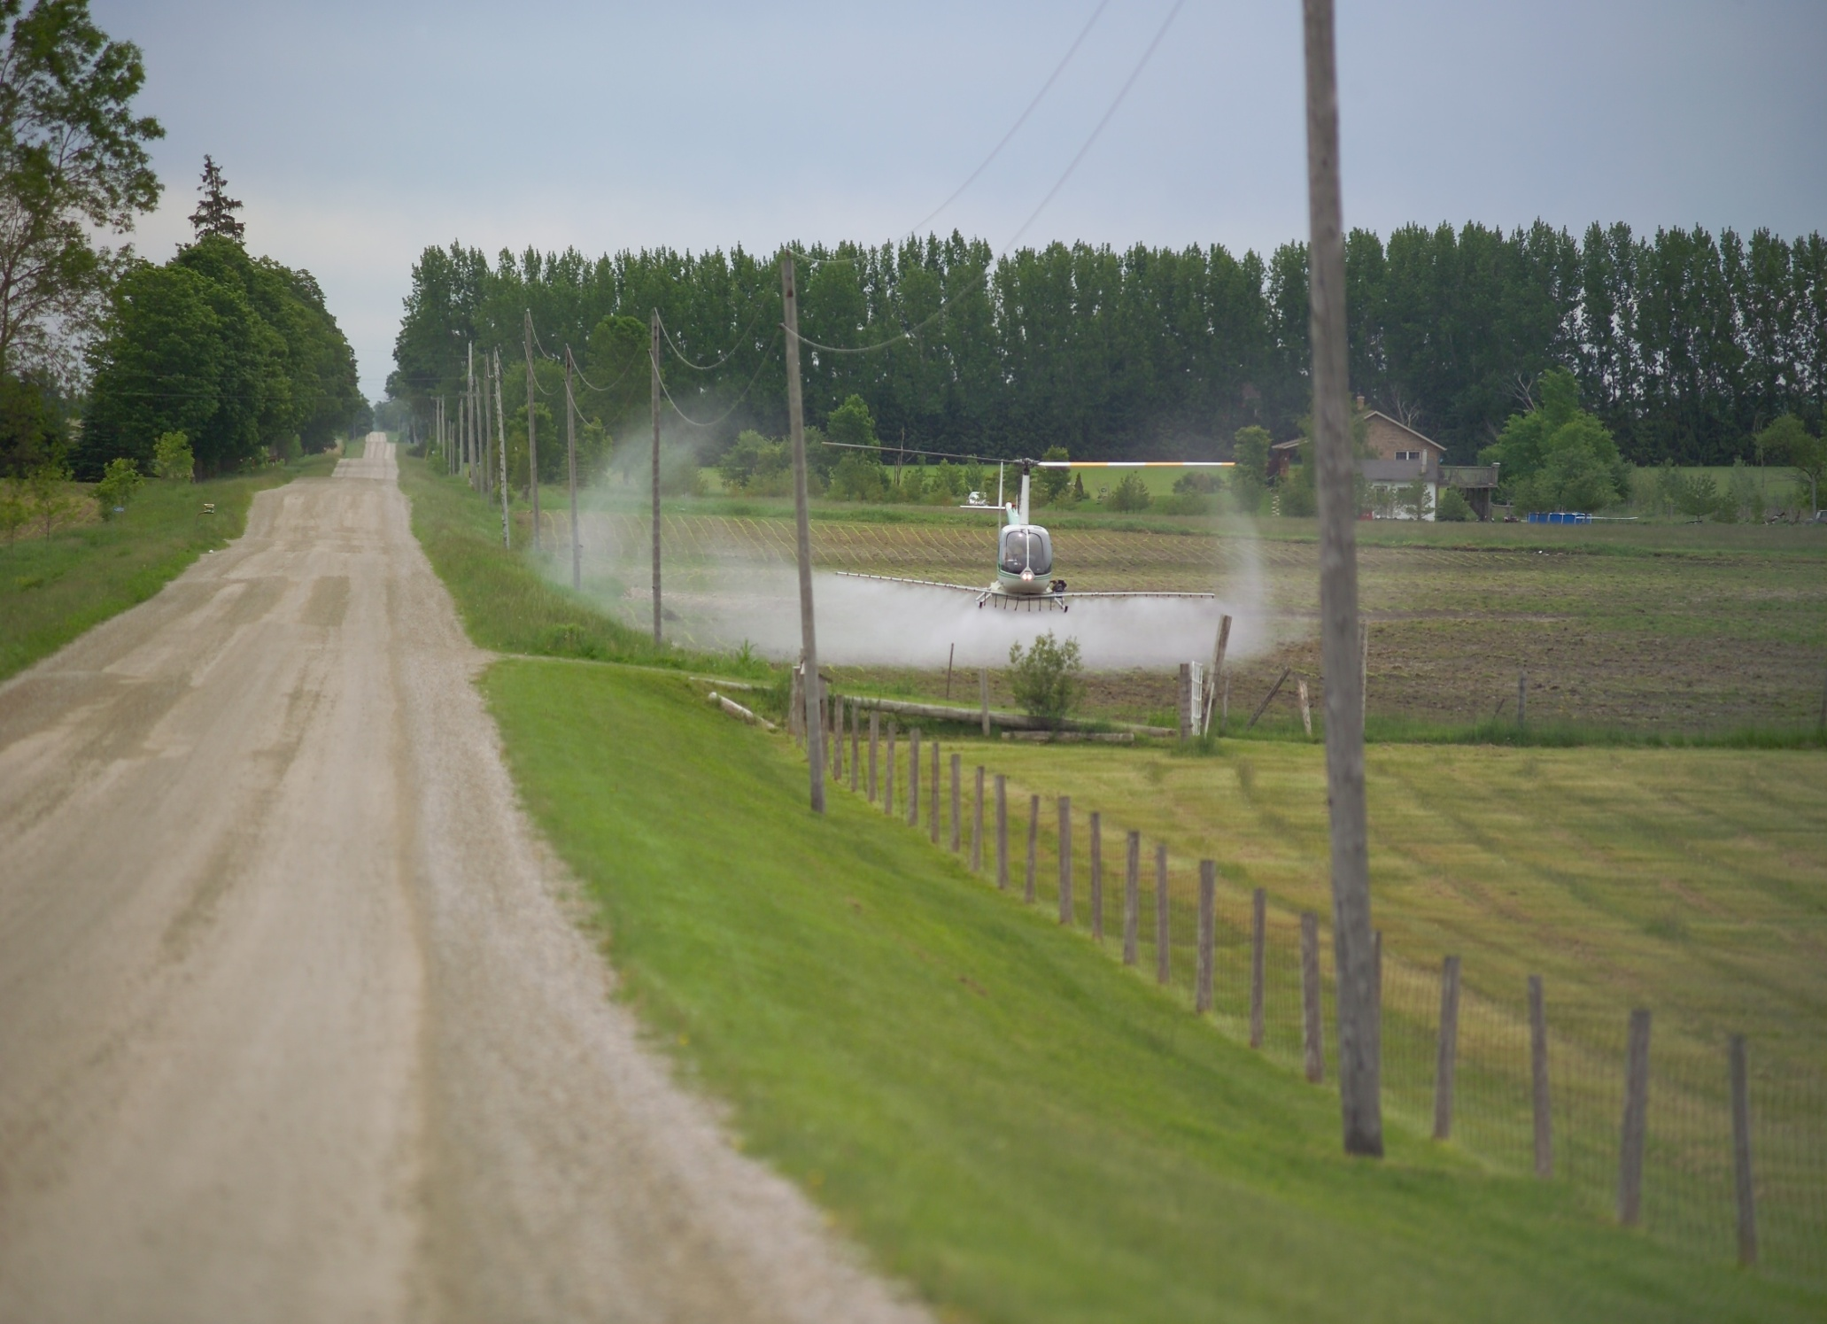
Another angle of a incorrectly set-up helicopter spray application.

Slide 13
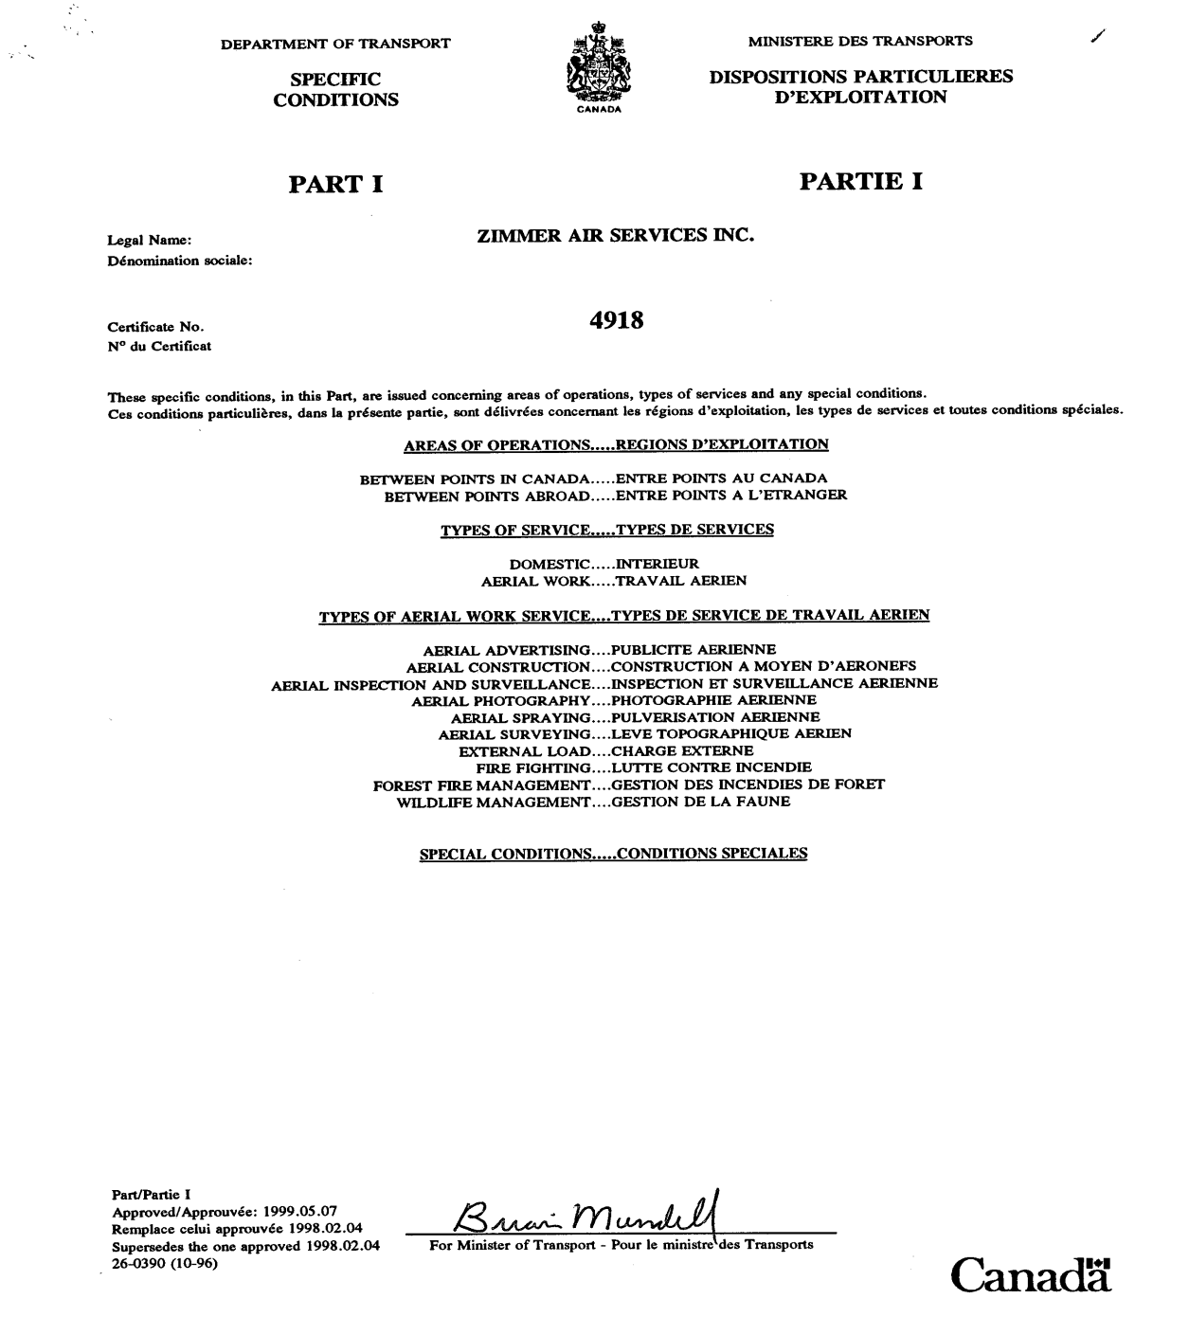
Transport Canada Operating Certificate
A number of legal requirements must be in place before operating an aerial spray service.
Transport Canada Operating Certificate
Pesticide Applicators License
Ministry of Environment Operators License
Insurance
Please ask us or your applicator to show proof.
AERIAL SPRAYING

Slide 14
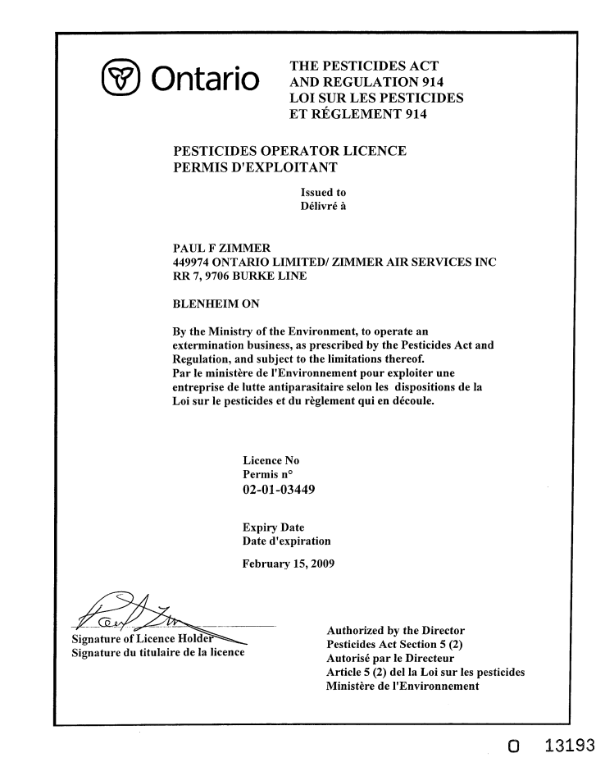
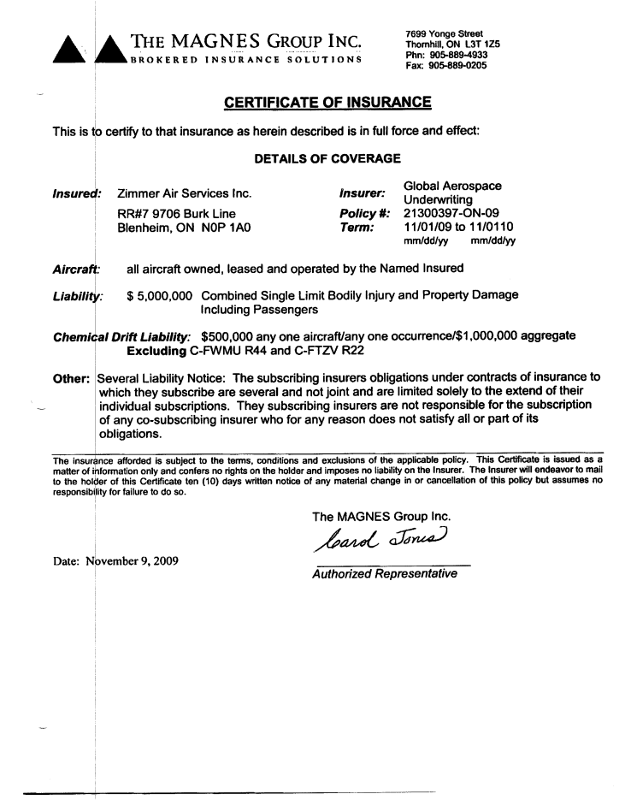
If the applicator you hire is not legally operating, their insurance is not valid and you may not be covered.
MOE Operators Certificate
Certificate of Insurance

Slide 15
What Zimmer Air Services Provides
Serviceable helicopter equipped with a properly calibrated spray system.
GPS Spray Guidance System
Mix and Load support equipment.
Water
All manpower required to carry out the application.
Copy of GIS data upon request.

Slide 16
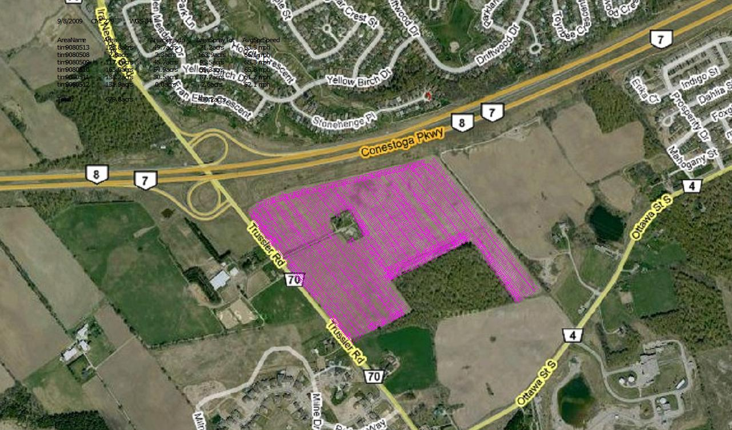
Example of GIS data overlain on Google earth.

Slide 17
What The Grower Provides
Directions to farm or field.
A field map & GIS shape file if possible.
Location on the map of any test strips to be left.
Mix & Load site, if required.
Identification of any sensitive areas, ie. (horse barn) or potential objectors to the spray operation.
Application spray window timing.
The correct amount of pesticide.
Billing and contact information.

Slide 18
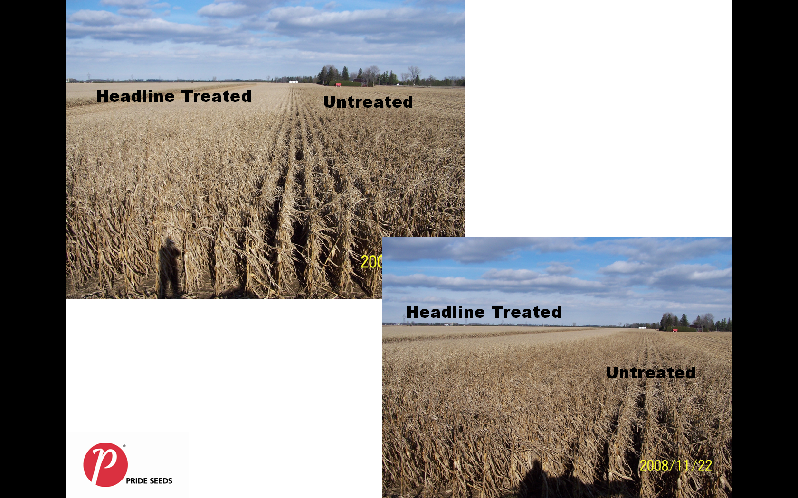
Photo courtesy of Stephen Denys Pride Seeds.

Slide 19
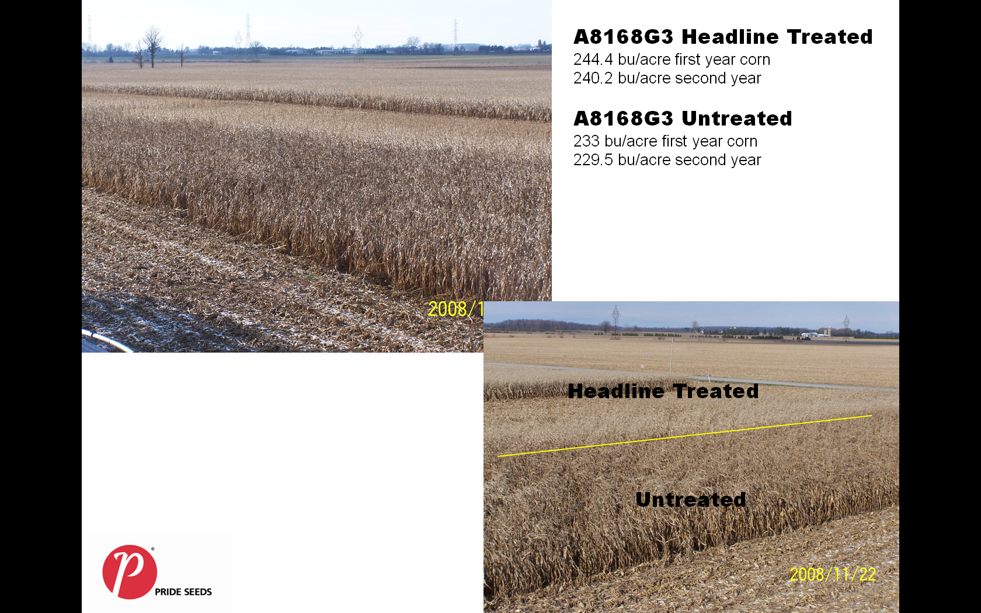
Crop protection product applied by Zimmer Air and assessed by Stephen Denys Pride seed rep on his own farm.

Slide 20
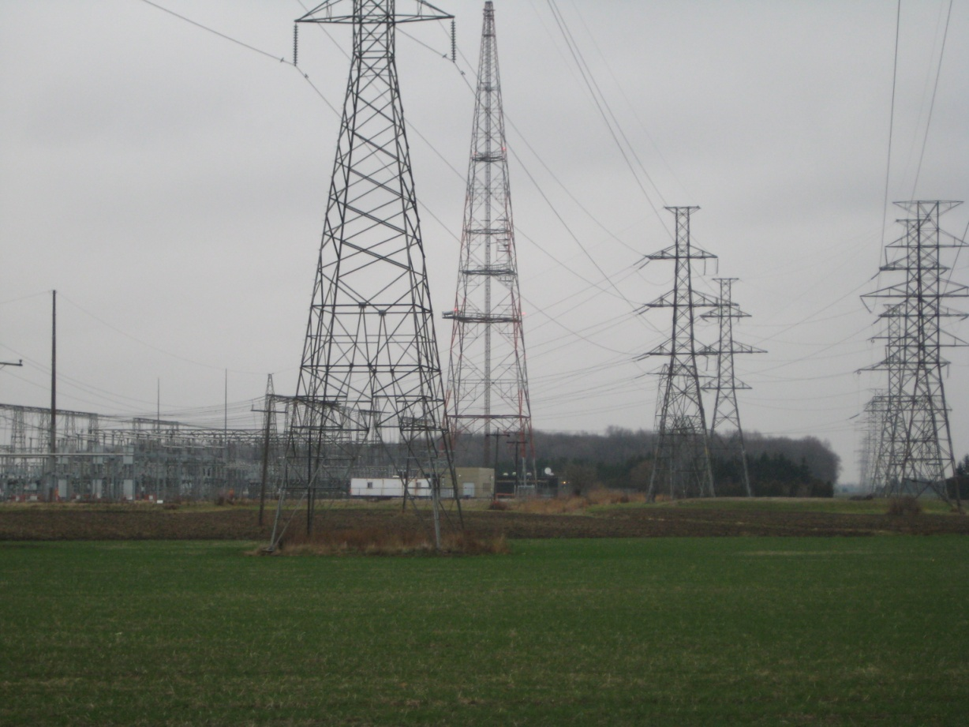
RESTRICTIONS
Some fields may not be effectively treated by helicopter because of the presence of hydro lines, wind farms, or proximity to human habitation.
We will accept the application job only if we can be assured that the safety of the pilot, and the public will not be compromised.
We may also turn the application job down if we cannot be assured that the quality of the application and subsequent results will not be compromised due to the obstructions.

Slide 21
CONTACT INFORMATION
Zimmer Air Services Inc.
9706 Burk Line,
Blenheim
Ontario. N0P 1A0
1-800-665-5485
1-519-676-9550
info@zimmerair.com
www.zimmerair.com

